Slide 1

Effort Aero Automated Software Cost and Effort Estimation
An Industrial Tool

Slide 2


Presented By:
Faizan Ahmed (70068241)
Usman Ahmed (70066997)

Slide 3
Introduction
A multi model solution for automating software cost and effort estimation. It is a platform for project managers and developers to collaborate and share their opinions on project cost.

Slide 4

Challenges of estimating a software project
Done with partial data
Often underestimated
Changing requirements

Slide 5

No Specialized Platforms
Monday.com
Jira
Asana
Great tools for managing project development BUT no pre development tools available

Slide 6
Objectives
Improve accuracy.
To get managers to switch to our system by automating their current estimation workflows and then integrating our specialized techniques with their existing workflows.
To make our system compatible with most of today’s trending programming languages and their popular frameworks.
To enable software development companies to estimate their projects earlier in time.

Slide 7
Comparative Analysis
Existing Solutions
Proposed Solution
Use older estimations models are used that can no longer accurately estimate today’s versatile development technologies
No multi model support, all calculations are based on one single algorithm hence single point of failure is applicable
Less accurate estimations. Since these programs have not been update according to modern development practices, their accuracies have degraded overtime
Combines a variety of well proven estimations models into an ensemble model that is trained on historical data
Provides platform to enable communication between management and developers to discuss and agree to a better estimate

Slide 8
Quick Introduction
EffortAero |Automated Software Effort And Cost Estimation
Effort Aero is a tool that provides various methods for software cost estimation.
It is a platform for project managers and developers to collaborate and share their opinions on project cost.

Slide 9
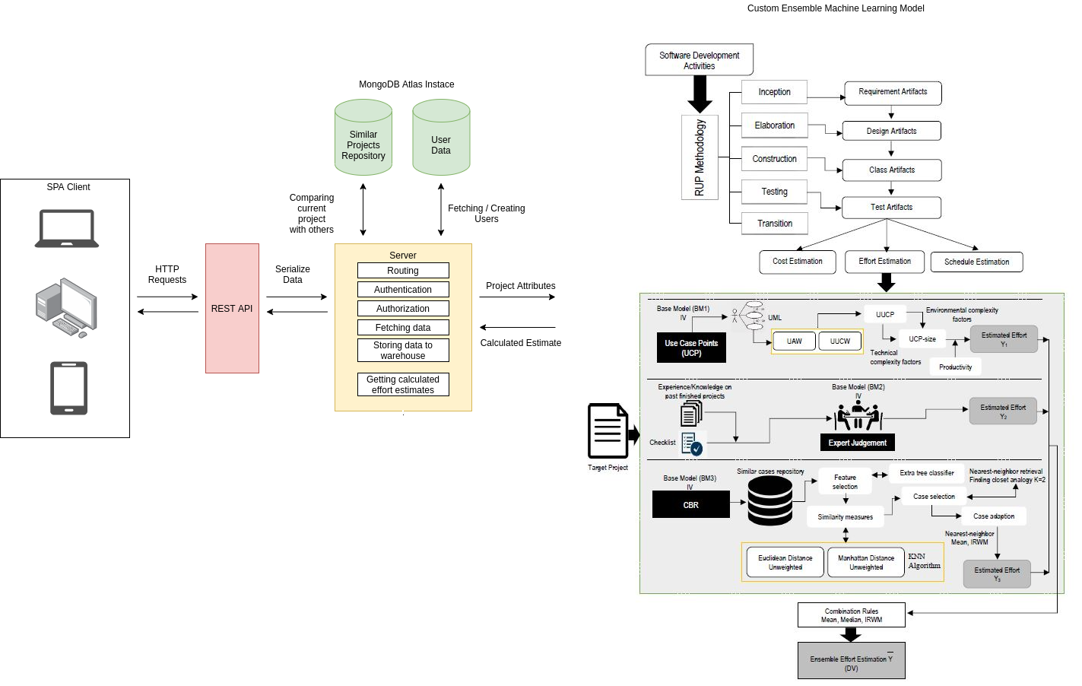
Architecture Design

Slide 10

Usage of the application
Register as an organization owner
Create organizations
Create projects in organizations
Fill in the attributes of project
Assign developers to the project
Get multiple types of estimates on your projects
Get insights about your estimations through Graphs and Charts
Register as a developer
Get assigned to projects
Give your opinions on the projects’ estimation via Delphi module

Slide 11
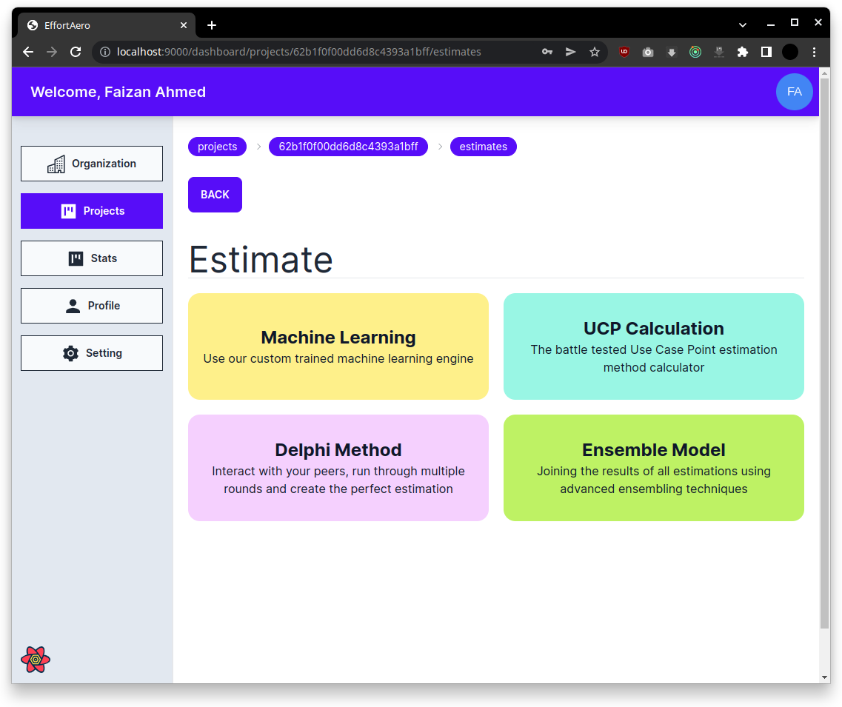
Estimation Methods
A platform that provides multiple methods for getting project estimates,
and improve initial client interaction and commitment

Slide 12
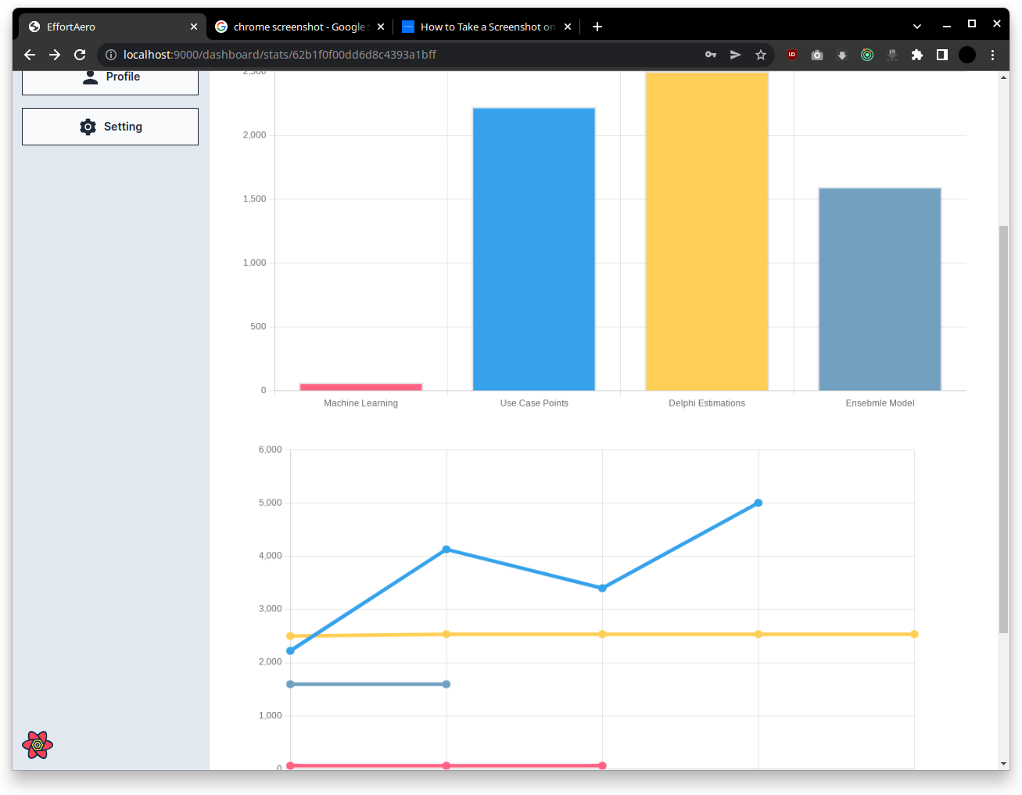
Statistics
After calculating efforts of project, these values can be visualized in form of informative graphs to give a better overall view of the project’s scope

Slide 13



Miscellaneous Features

Slide 14







Technologies
Front End
React
Tailwind
React Query
Back End
Nest JS
Node JS
Database

Slide 15
Significance
Improved Accuracy
More time for development
Less budget for estimation

Slide 16
Limitations
Small Dataset
Academia Research Limitation

Slide 17
Contribution
The Work Breakdown of the EffortAero is in following:
Faizan Ahmed
UI Development
Frontend Design (Prototype)
Usman Ahmed
API Integration
API Development
Database Schema

Slide 18
Conclusion

Slide 19
Effort Aero can be great asset to managers and business development execs that are responsible for keeping the client updated on their project’s cost and time schedule

Slide 20
Future Enhancement
Adding Manager as well as Developer to the system from outsource company.
Develop a Freelance subsystem for Outsourcing
Adding NLP to determine the UCP if user can add the UCP in form of JPG or PNG.
We will shift our Database as centralized database or distributed database.

Slide 21
THANK YOU
UNIVERSITY OF LAHORE
FYP-21-28
DEPARMENT OF SOFTWARE ENGINERRING
BATCH 2018-2022

